Slide 1




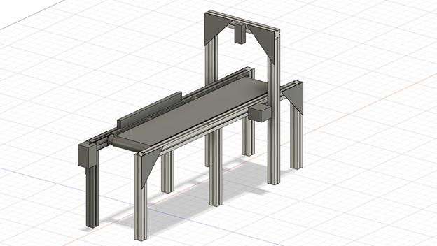

ECE477 MIDTERM DESIGN REVIEW: TEAM 16
<Add team picture or relevant project picture here>
Notes:
Jason

Slide 2
OUTLINE
Project Overview
Major Components
Block Diagram
Packaging Design
Electrical Schematic
PCB Layout
Prototyping Progress
Software Development Status
Project Timeline
Questions
Notes:
Jason

Slide 3
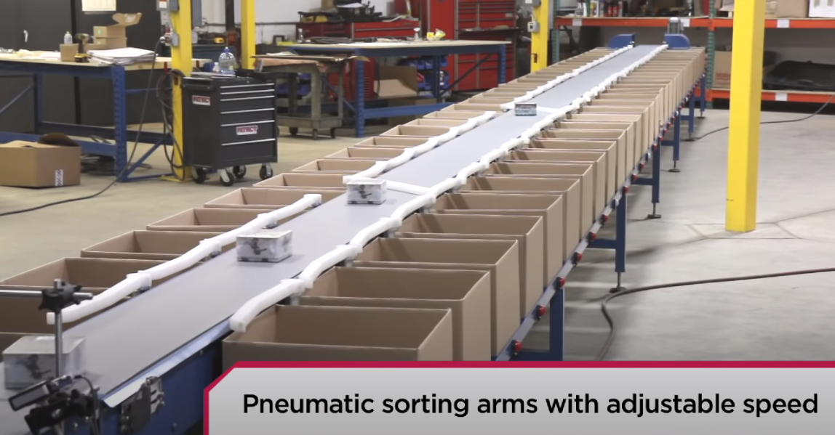
PROJECT OVERVIEW
Smart Conveyor Belt System
Sorts packages to different compartments based on barcode information.
More accurate by using 2D barcode scanner
Easy to implement, low maintenance cost
Gentle sorting mechanics protects fragile packages
Customizable sorting rules
Notes:
Jason

Slide 4
PSSCS
An ability to interface with a/multiple barcode scanners
An ability to control all servo positions using level-shifted pwms of variable duty cycle originating from the mcu.
An ability to interface with a motor driver so that our microcontroller can control movement of the conveyor belt.
An ability to interface with an IR sensor in order to detect a package location
An ability to rapidly switch sorting positions to organize packages using microcontroller signals and logic with minimal runtime.
Notes:
Jason

Slide 5
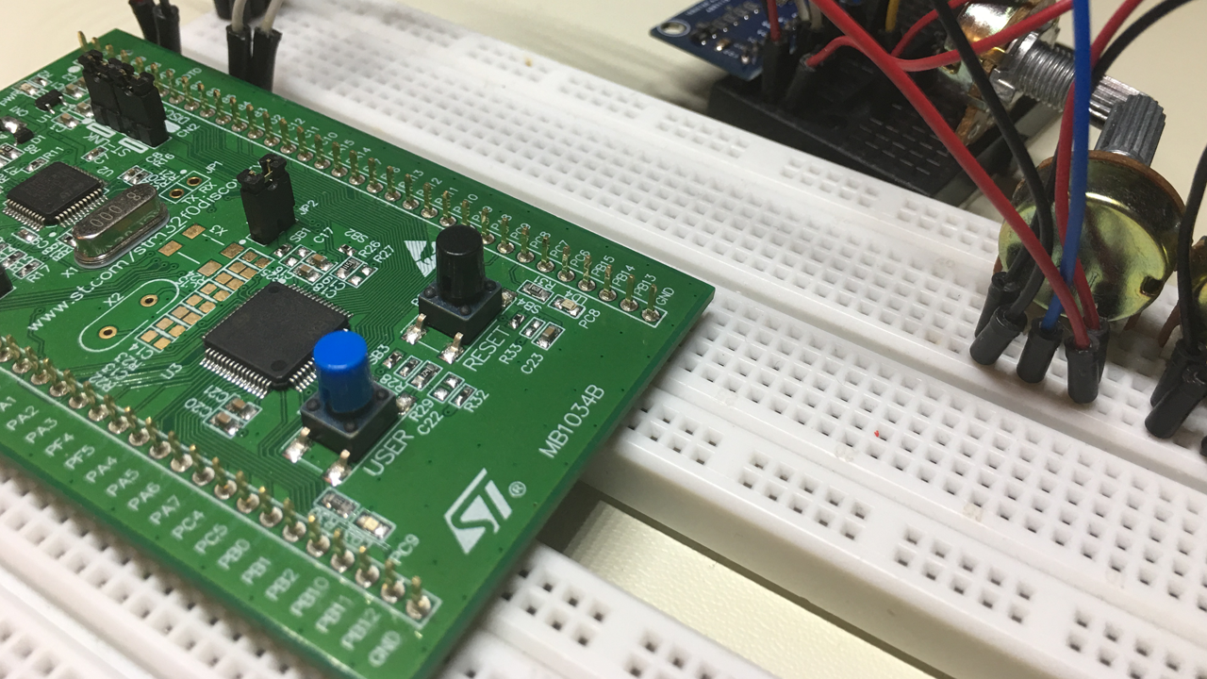
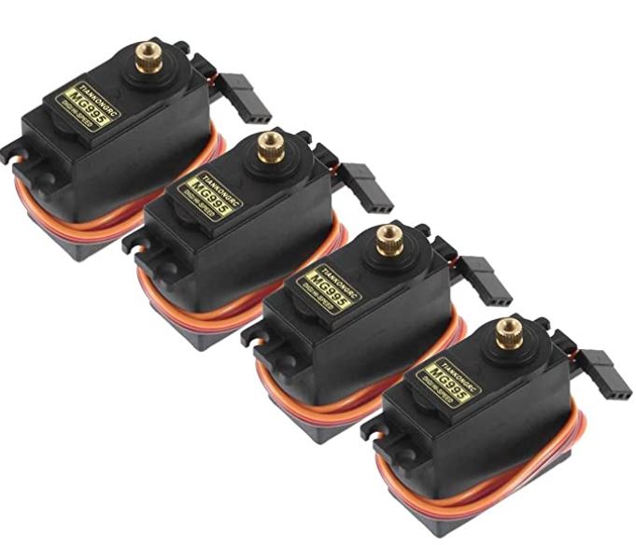
MAJOR COMPONENTS
Microcontroller (MCU) + Servo Motors
STM32F0 Discovery:
Internal clock 48 MHz
2 UART connections
11 timers
I2C connections
Interface with and commands
all other components
Servo Motor (3V-7.2V) [MG995]:
Sufficient Torque
Operational Voltage: 4V - 7.2V
Stall Torque:12 kg.cm@ 6V, 13kg.cm@7.2V
Rotates flaps to sort parcels
Notes:
zi

Slide 6
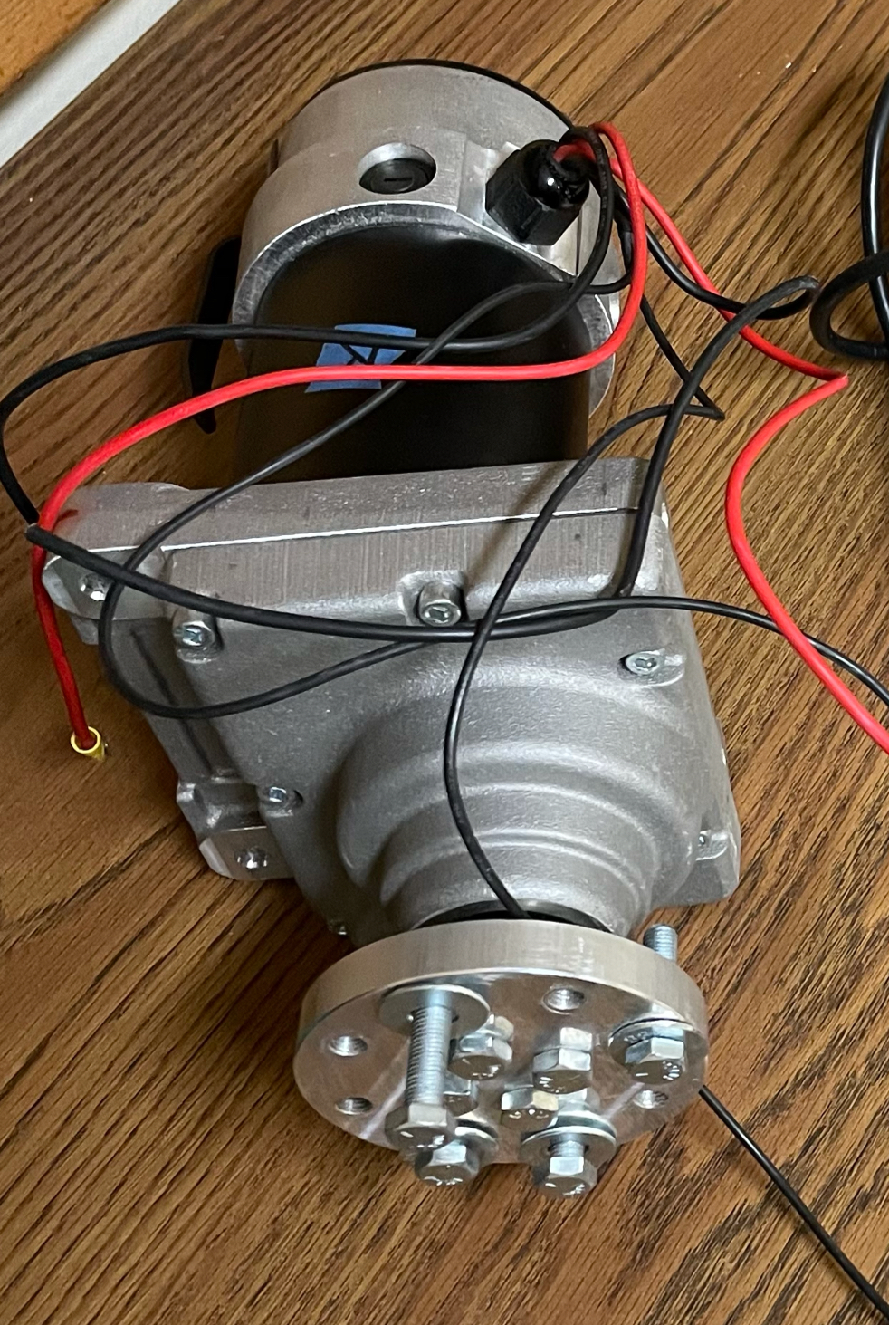
MAJOR COMPONENTS
DC Motor
NPC-T74:
24V, ~4A (no-load)
Will run at 12V
240 RPM
1.09 HP Peak
Need ~0.1 HP
Drives Conveyor Belt to move
parcels through system
Notes:
zi
@24 V draws 4A will be operating at 12V
More than sufficient for our project need

Slide 7
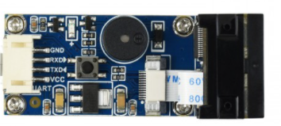
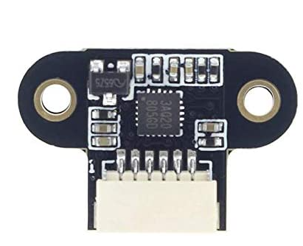
MAJOR COMPONENTS
Sensors
Barcode Scanner [14810]:
1D/2D code reader. e.g. QR code
Works in the dark
(5V at 135 mA)
Utilizes UART
Reads and delivers parcel barcode information to MCU
Distance Sensor [TOF10120]:
3V - 5 V at 35mA
UART + I2C
Oper. Dist. 100 - 1800mm
Monitor distances of parcels
Notes:
Zi
transition

Slide 8
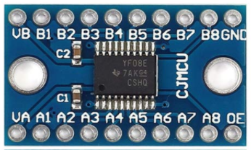
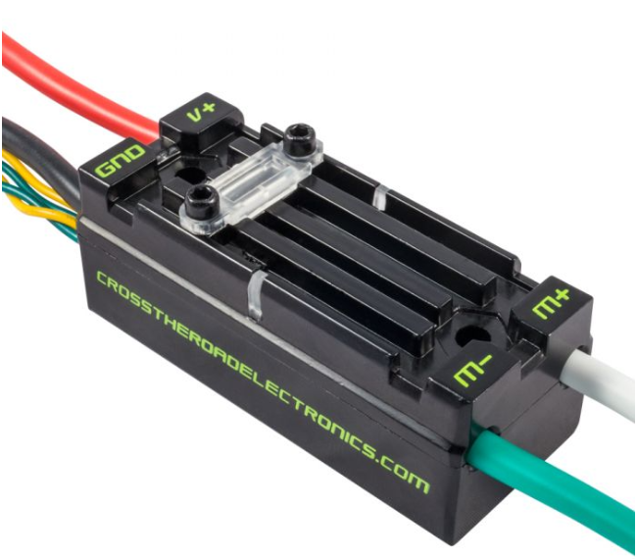
MAJOR COMPONENTS
Logic Level Shifter + Electronic Speed Controller (ESC)
Logic Level Shifter [709804]:
Bi-Directional
Steps 3.3V signals to 5V signals
VCCA side voltage range: 1.2V-3.6V;
VCCB side voltage range: 1.65V-5.5V
Takes in signals from MCU at 3.3V and outputs signals at 5V
Electronic Speed Controller [217-8080]:
12V Nominal voltage
60A continuous current rating
Controlled via PWM or CAN
Control the speed of DC motor that drives conveyor belt
Notes:
Jonah

Slide 9
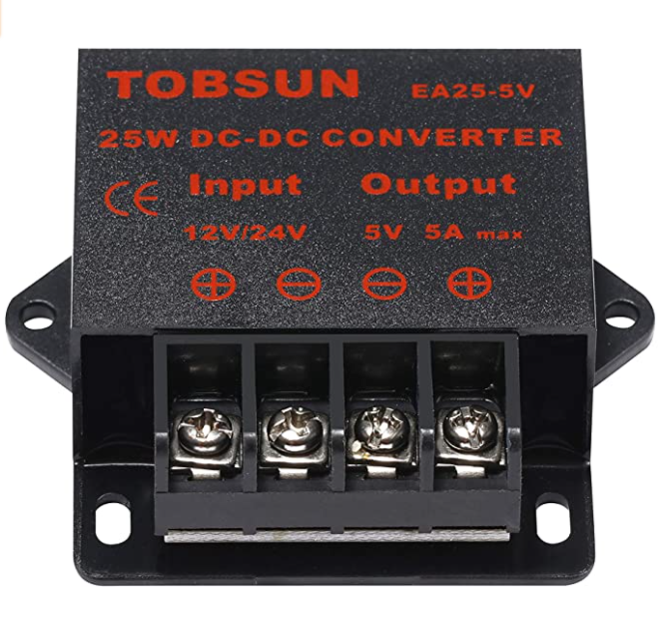
MAJOR COMPONENTS
Voltage Regulator
Voltage Regulator/ Buck Converter [EA25-5V]:
Converts 12V/24V to 5V
Max current output: 5A
>90% Efficiency
Notes:
Jonah

Slide 10
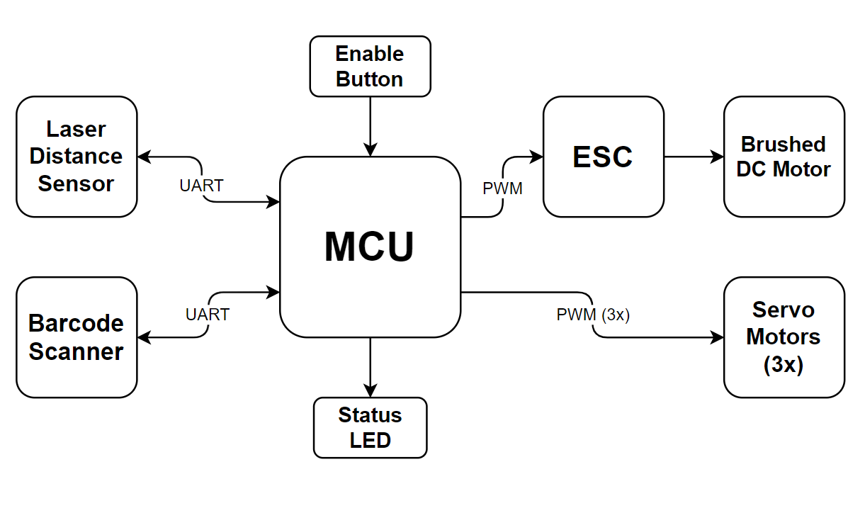
BLOCK DIAGRAM
Notes:
Jonah

Slide 11
PACKAGING DESIGN
4.
3.
1 m
5.
20.32 cm
1.3 m
1.
1) Motor plus belt
2) Sprocket connecting belt to roller
3) Servo + Bumper
4) Barcode Scanner
5) Microcontroller and PCB case
2.
1.2 m
Notes:
Ryan
Include one or more images of your packaging design here. Include relevant dimensions and how you are planning to manufacture your product packaging.

Slide 12
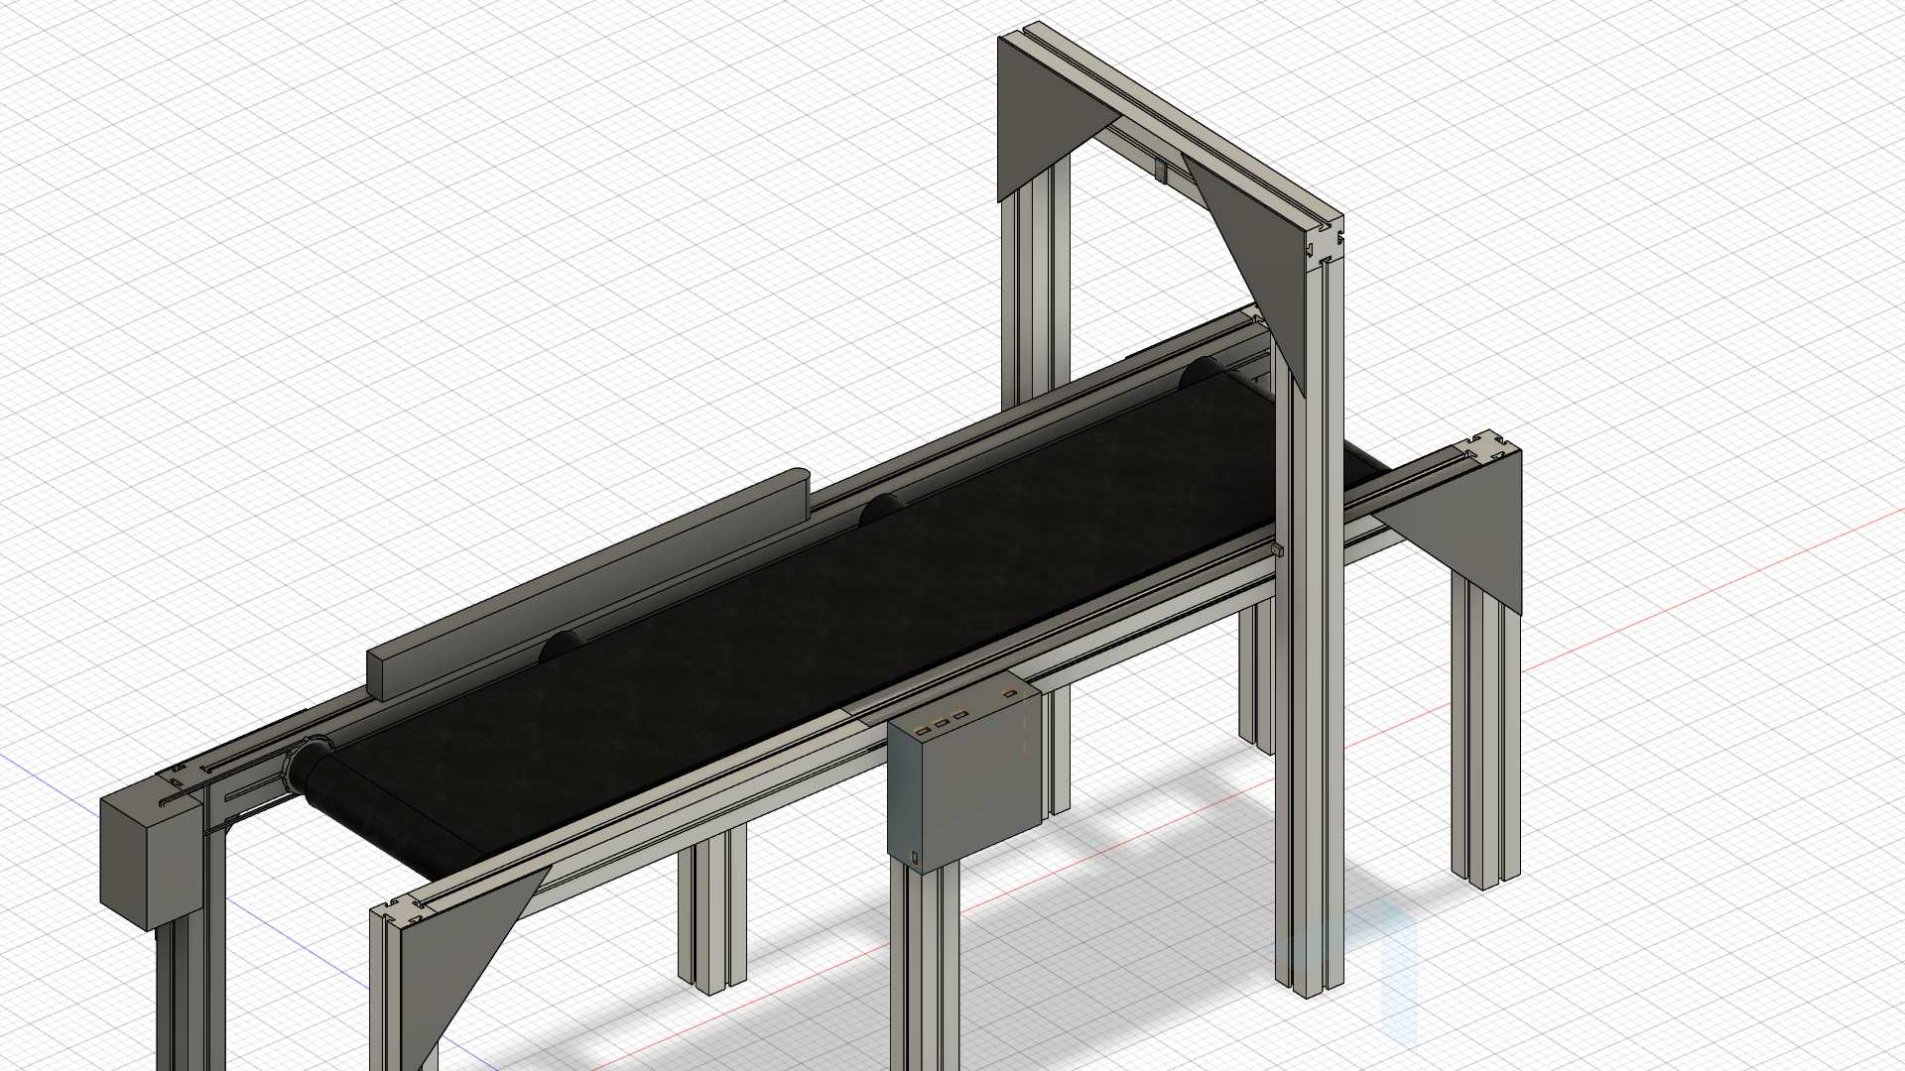
Packaging

Slide 13
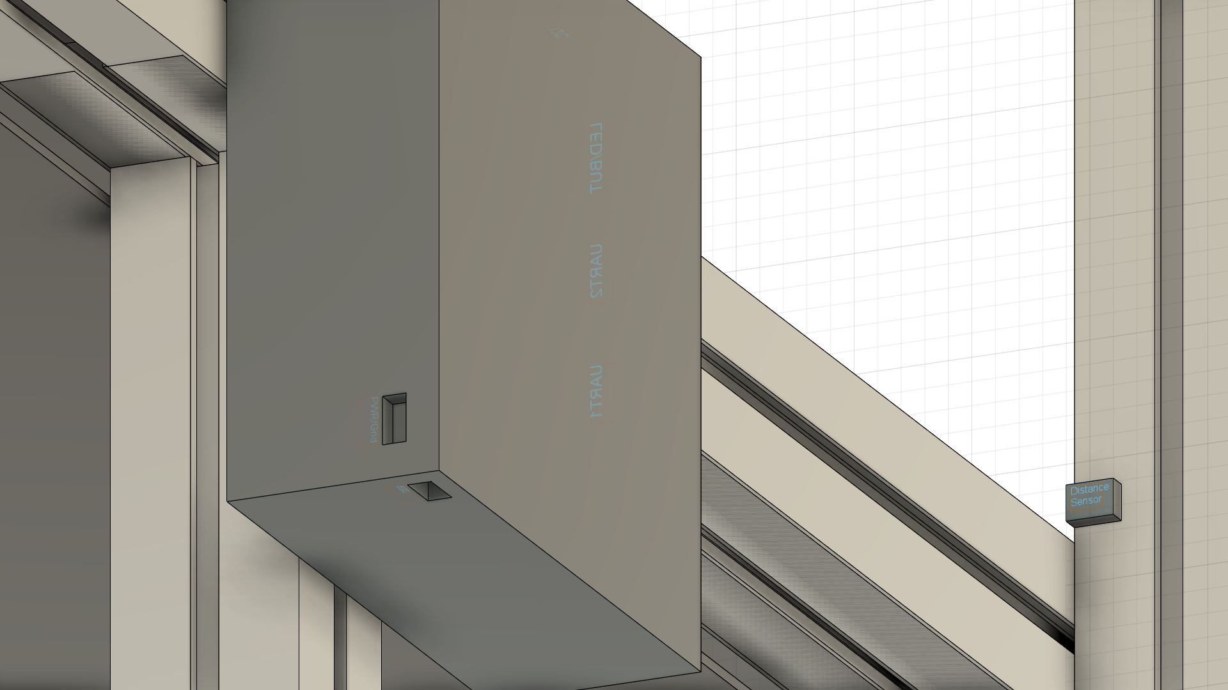
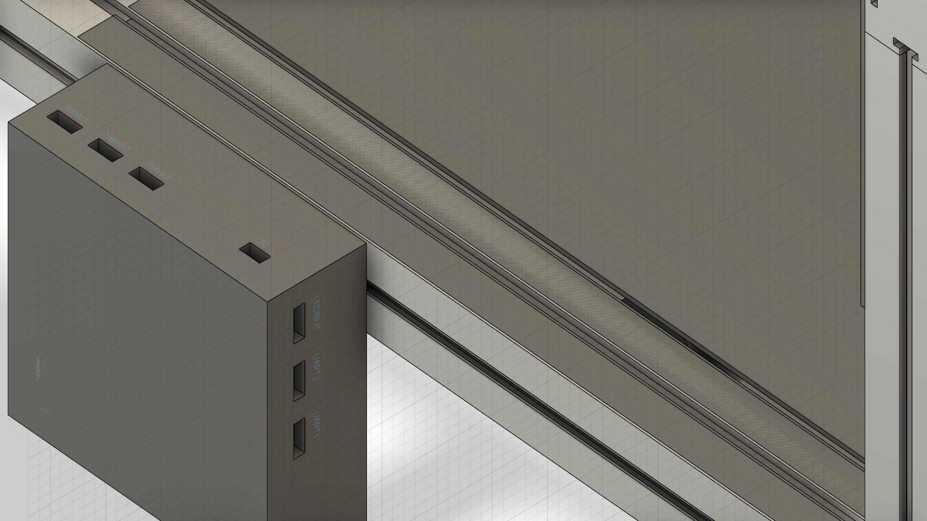
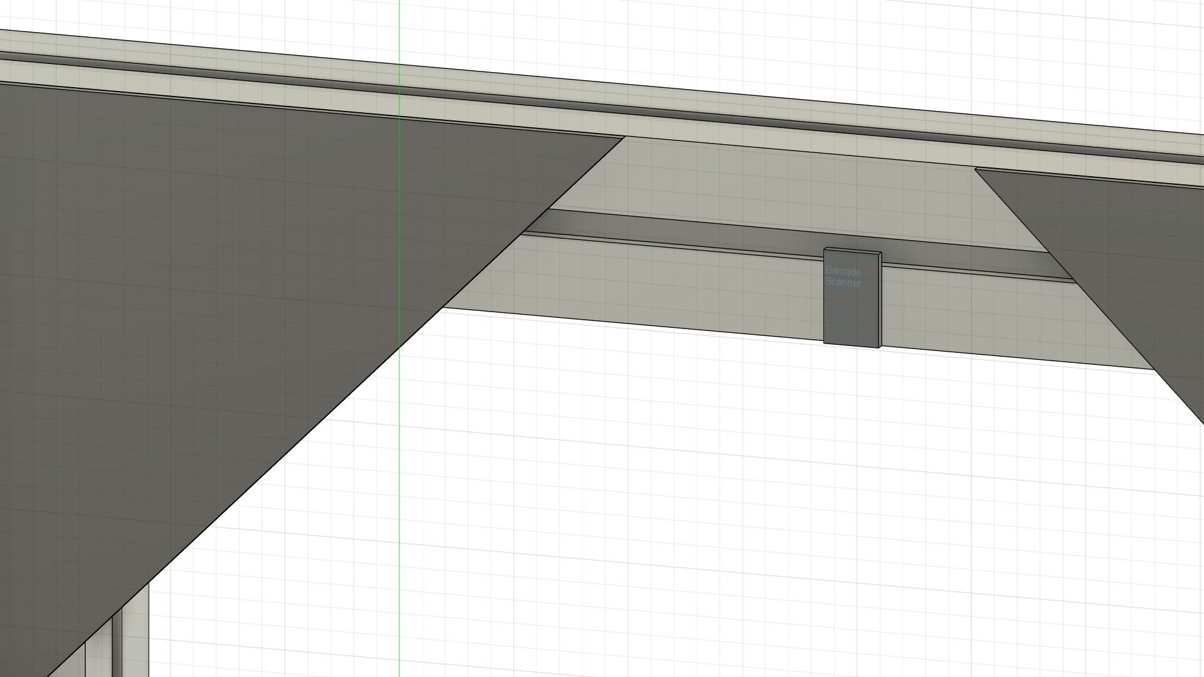
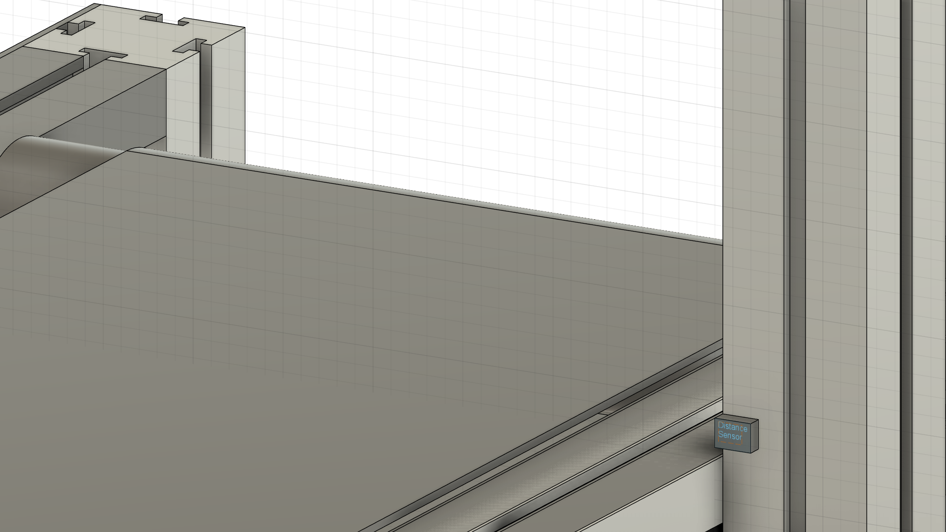
Packaging Design
5in x 5in x 1in
5in x 5in x 1in
1in x ¾ in x ¼ in
1in x ½ in x ¼ in

Slide 14
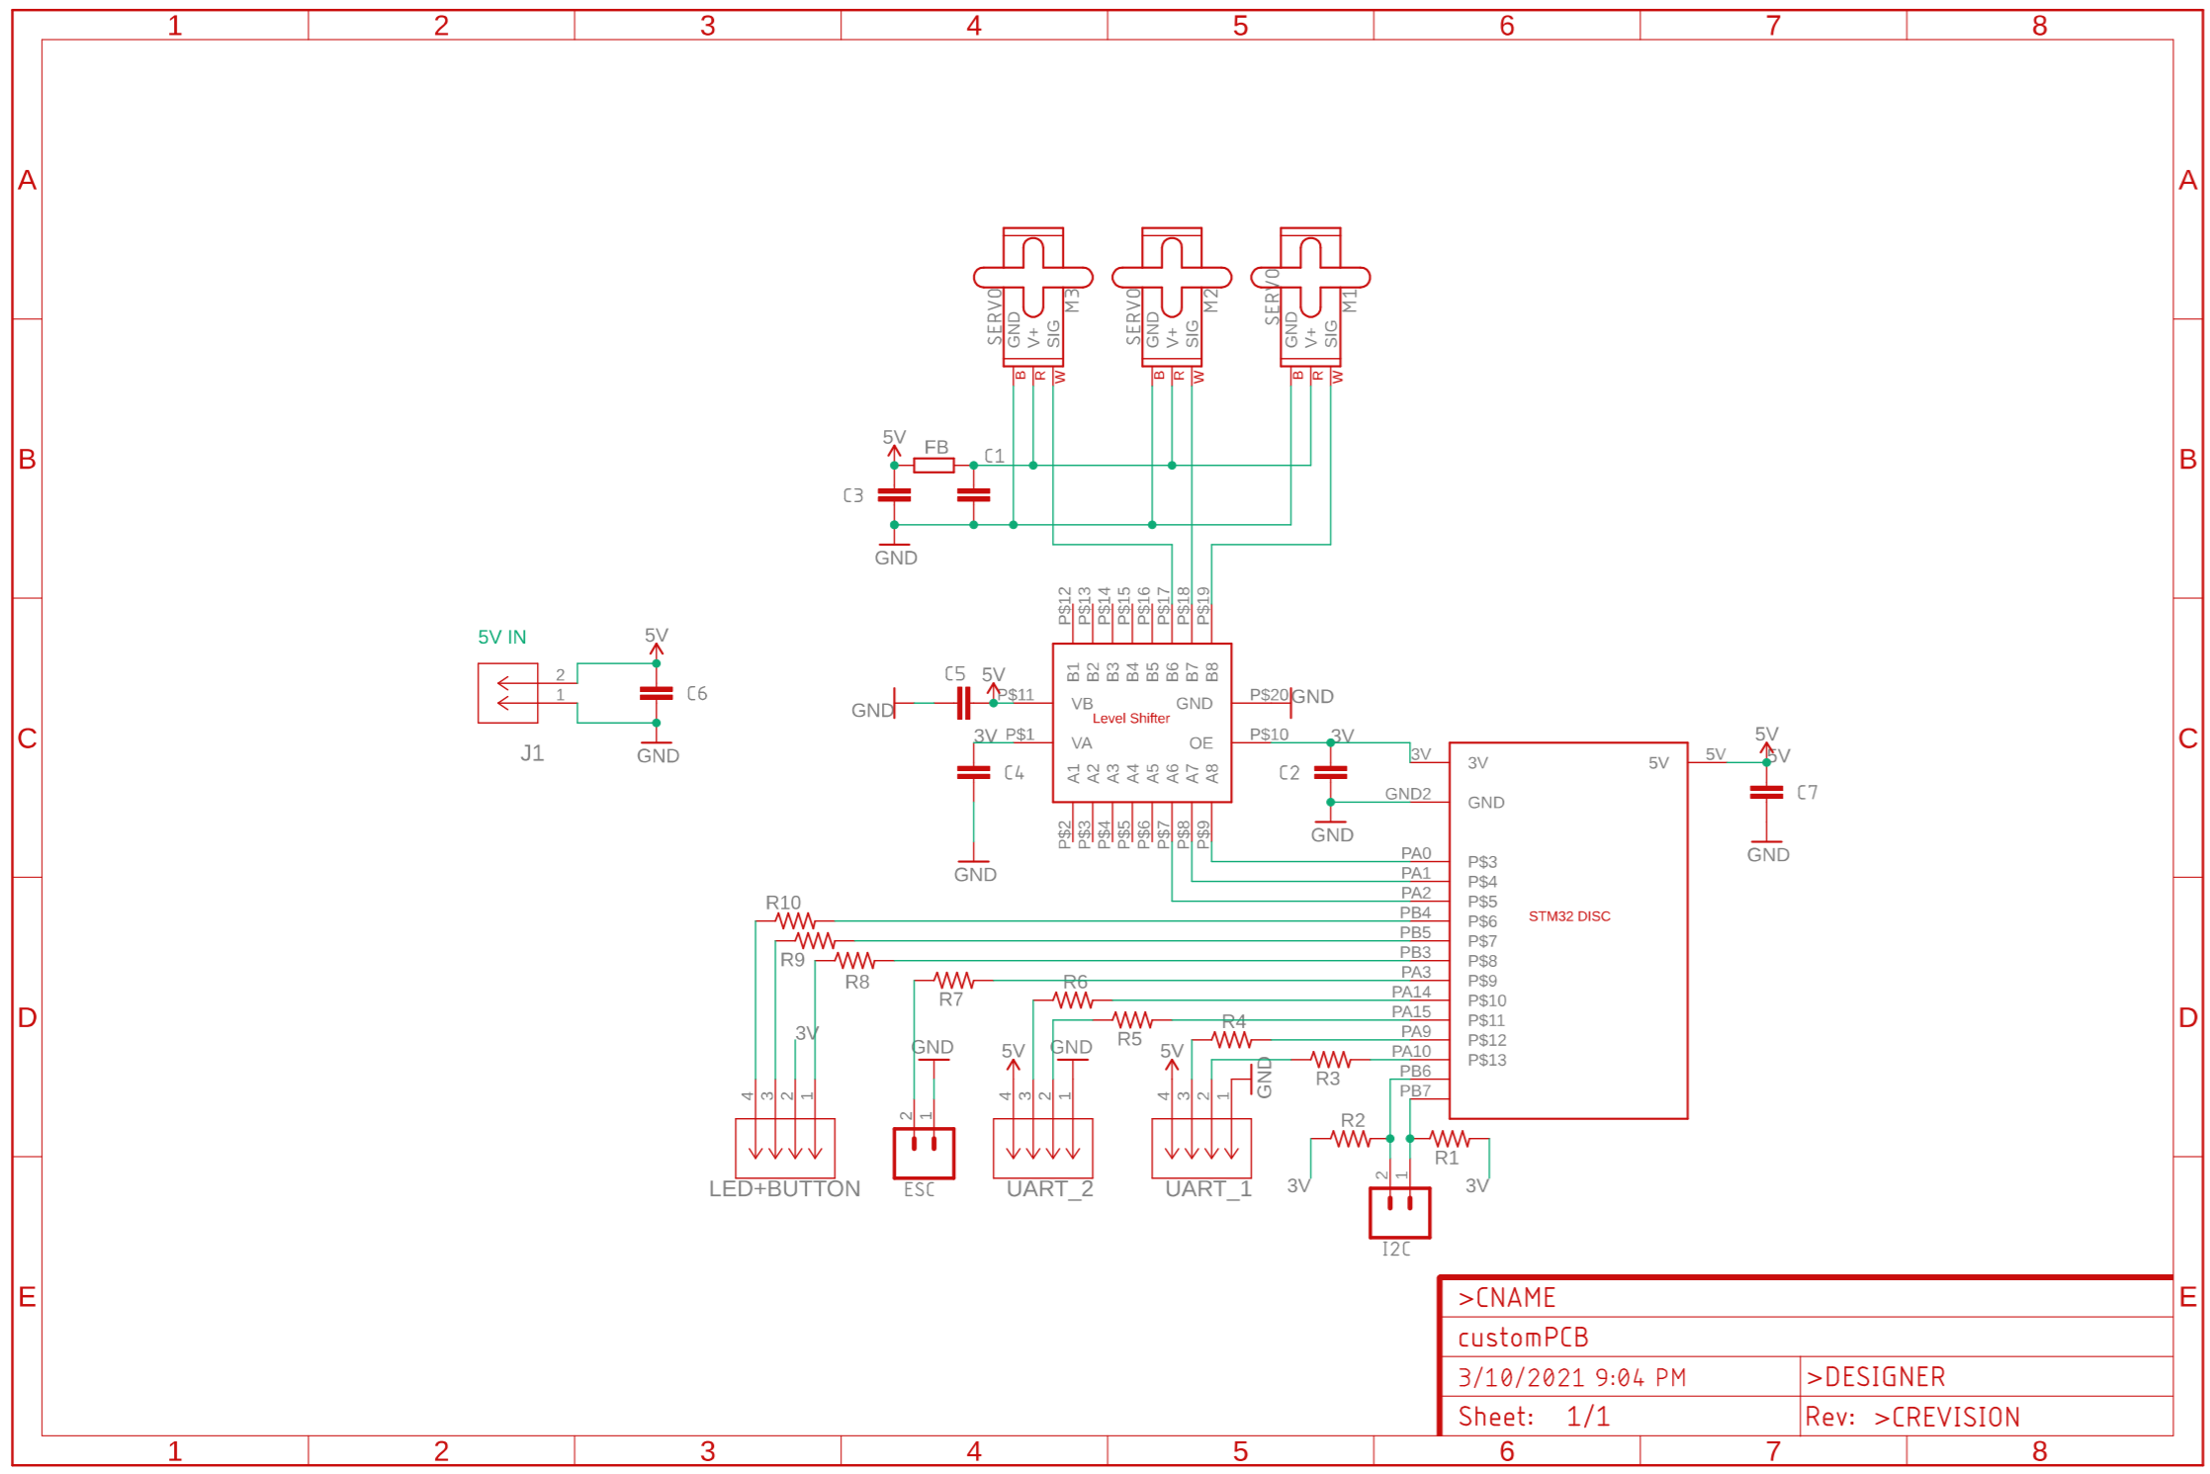
ELECTRICAL SCHEMATIC
ELECTRICAL SCHEMATIC
Notes:
Jonah
Include one or more views of your electrical schematic here. If necessary, break up this section into multiple slides detailing various subsystems which are easily viewable (Hint: a zoomed out view of a large electrical schematic in which nothing can be read will not be helpful for the design review). Your schematics should be complete, organized, and readable.

Slide 15
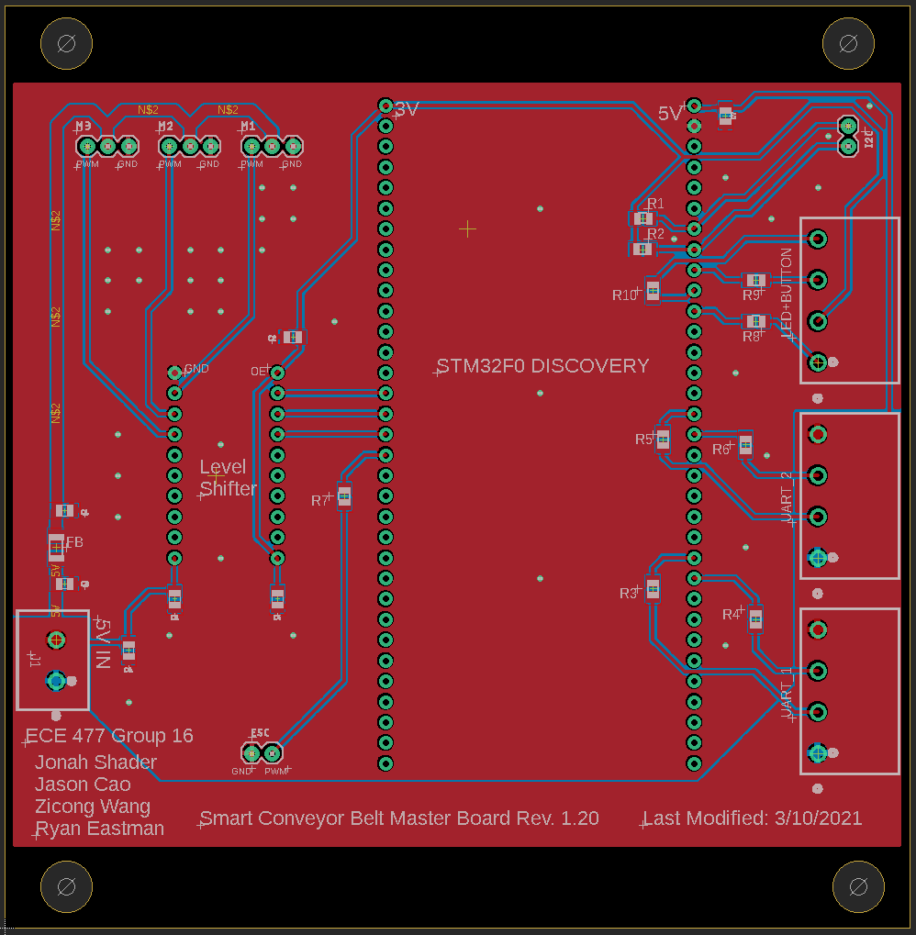
PCB LAYOUT
Width: 4.399in
Height: 4.487in
Hole Diameter: 0.25in
Notes:
Jonah
Include one or more views of your PCB Layout here. If necessary, break up this section into multiple slides detailing various subsystems which are easily viewable (Hint: a zoomed out view of a large electrical schematic in which nothing can be read will not be helpful for the design review). Your layout should be complete, organized, and readable.

Slide 16
PROTOTYPING PROGRESS
Component | Status
Distance Sensor | Testing In Progress
MCU
DC Motor
Electronic Speed Controller
Barcode Scanner
Servo Motor
Conveyor Belt | Not implemented yet
Status LED
Enable Button
Notes:
Ryan

Slide 17
SOFTWARE DEVELOPMENT STATUS
Not Yet Started | In Development
Package Sorting Algorithm | Reading distance sensor information
Data Structure | Reading & sending barcode to MCU
Notes:
Ryan

Slide 18
PROJECT TIMELINE
Testing of level shifter and making sure microcontroller produces correct PWM signal to drive servo motors
Trials of full system without real parcels first with belt running, then run the full system with full capacity
Testing Barcode scanner functionality and maximum speed of reception
Integration of DC motor and conveyor belt frame
WEEK 10
WEEK 12
WEEK 14
WEEK 16
WEEK 9
WEEK 11
WEEK 13
WEEK 15
Testing conveyor belt framework for future integration of mechanical and electrical parts
Integration of servo motor, level shifter, sorting flaps with the conveyor frame.
Testing distance sensor and the I2C interface
More full operation trials and product function demonstration
Notes:
Zi

Slide 19
3D PRINTING
Questions?

